Slide 1



Group Members:
Purvesh Mavle
Pranav Mahamunkar
Varun Madkaikar
Devang Mane
Guide Name : Mrs Rupali Sarode

Slide 2


Introduction
Hello folks, we at BOLI BAZAAR are here to create a virtual market place for all our beloved antique collectors to explore this age old hobby with a modern twist. Here our users will be able to buy or sell their antiquities in a safe and secure way from the comfort of their home.

Slide 3


Understanding the market
After an item is listed by the owner on the website , it is then verified and an inial quote is made. After that an auction is scheduled. If the item goes without any bid then it is returned to the original owner. Otherwise the item is delivered to the winner of the auction.

Slide 4
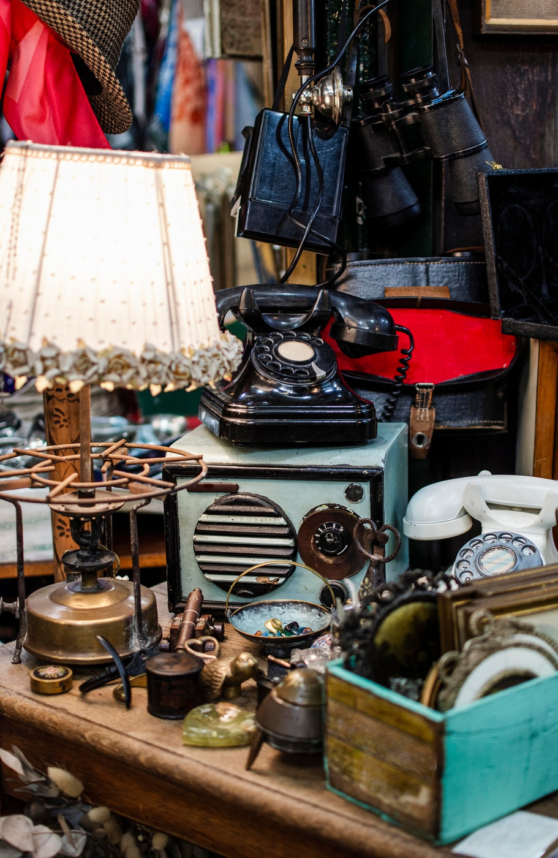
Problem Statement
We all know there are numerous
available sites for
the same reason but none of them have assured us
proper customer support, safe environment with
original value things.
Also to create Mobile responsiveness and accessibility.

Slide 5

Objectives
Safeguarding the interests of potential buyers by enhanced security
Transparency and Trust
Community Building
Mobile accessibility
Customer support
Utilising Auction Analytics

Slide 6

Motivation:
Exploring History
Our own alignment and interest in this field
Creating a community of such antique collectors
Protection of such valuable products

Slide 7
Technology Used:
HTML
JavaScript
Node JS
REACT
CSS

Slide 8
Literature Survey
Platform | Existing Solutions | Methods | Advantages | Disadvantages | Links
eBay | English, Dutch, Penny auctions | Proxy bidding, sniper bids, automatic bidding | Large user base, diverse categories, established reputation | High fees, complex interface, shill bidding risk | https://www.ebay.com/
Amazon | Sealed-bid auctions | Proxy bidding | Trusted platform, fast transactions, secure payments | Limited auction availability, mostly new items, high competition | https://www.amazon.com/auctions
Catawiki | Curation-based auctions | Expert-led, timed auctions | Unique and rare items, authenticity guarantee, secure platform | High fees, limited bidding window, potentially inflated prices | https://www.catawiki.com/en/
Proxibid | Online estate and business auctions | Varied auction formats, live bidding option | Convenient access to estate sales, diverse items, potential for bargains | Limited item descriptions, location-specific, requires registration | https://www.proxibid.com/
The Auction Room | High-value art and collectibles auctions | Live bidding with video streaming, expert appraisals | Access to valuable items, transparent process, professional platform | High fees, limited audience, requires registration | https://www.the-saleroom.com/en-gb

Slide 9
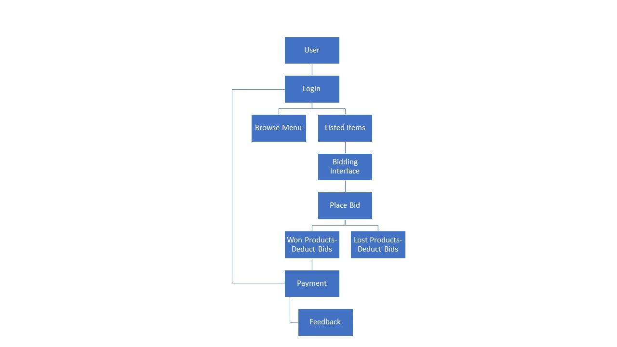
Block Diagram

Slide 10
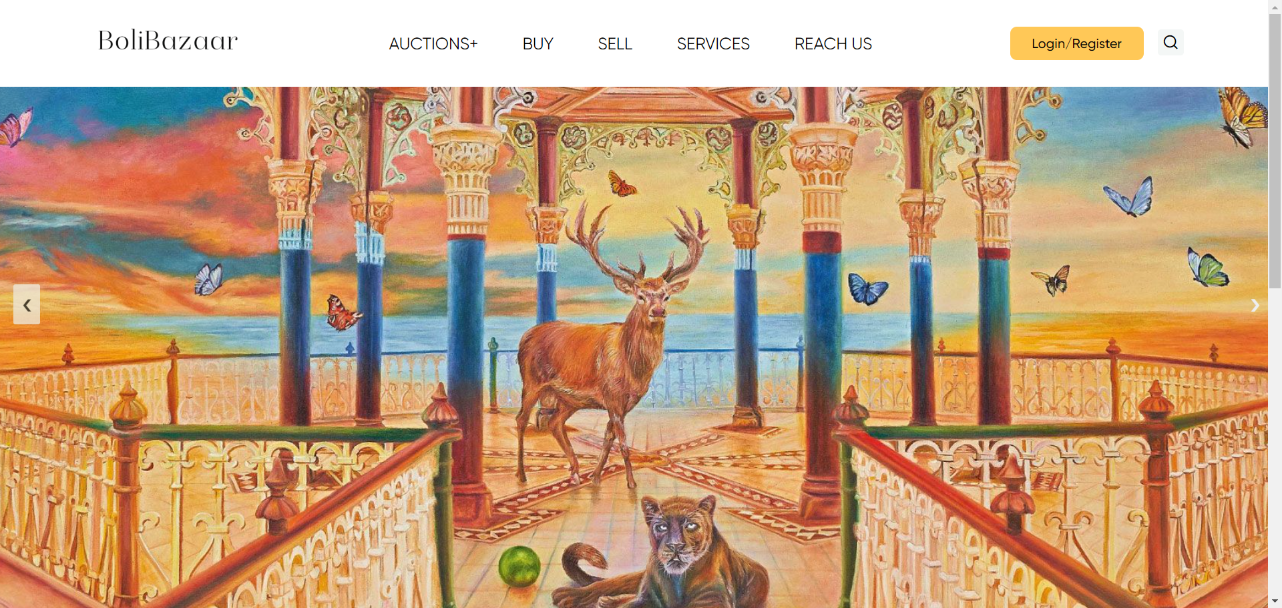
GUI Design:

Slide 11
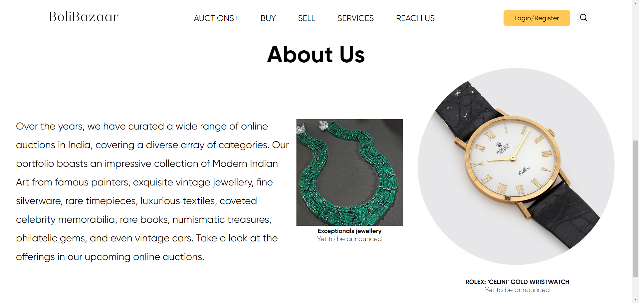

Slide 12
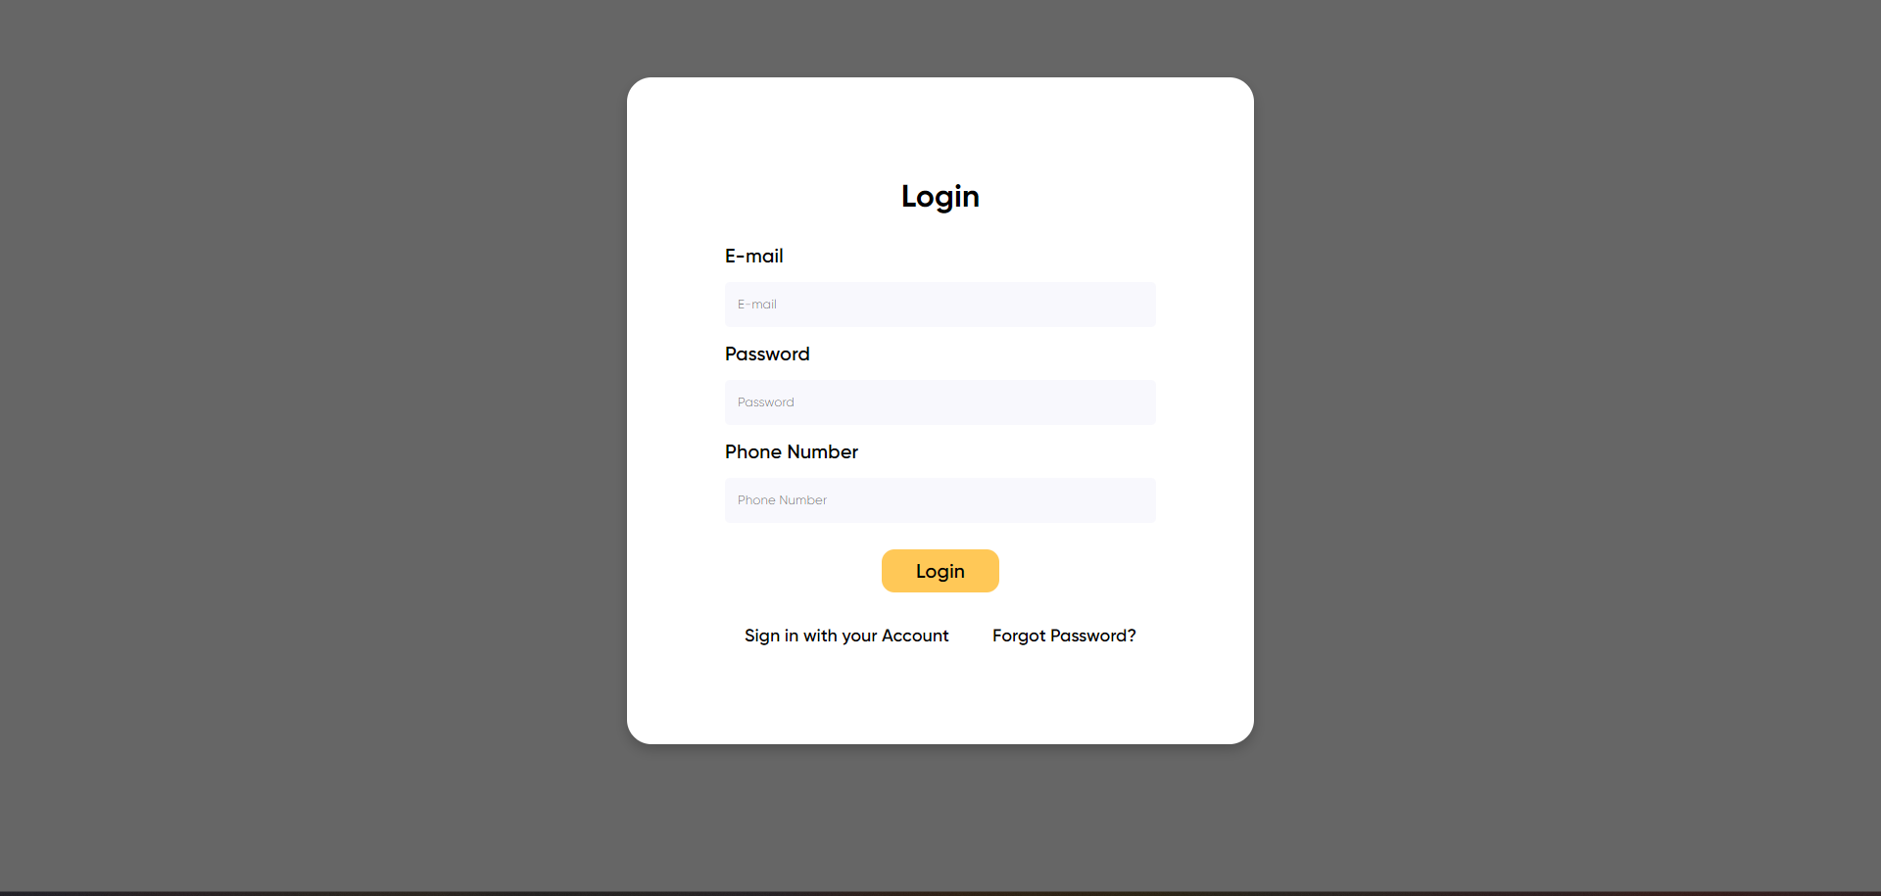
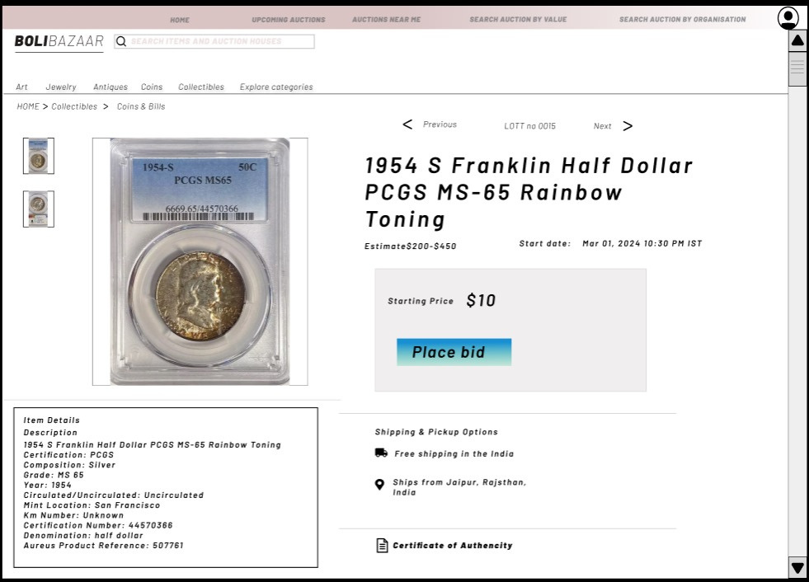

Slide 13


Conclusion
The objectives of such a platform include providing a user-friendly interface, fostering a sense of community, and organizing special events to enhance the overall experience. Emphasizing transparency, global reach, and customer support further ensures the success of the website.
Future Aspects :
To expand this website for more diverse antiquities
To reach all offline Auctioneers and together make this process hassle free

Slide 14

Thank You

